Slide 1
Deaths – ONS Data – UPDATE
ONS have released (as of 28/04/2020) weekly deaths broken down to local authority level, of all deaths and COVID-19 deaths. This dataset will be published every week and includes deaths outside of hospital.
Weekly deaths have been provided for 2020 and from March 31 COVID-19 deaths relate to any death involving coronavirus (COVID-19), based on any mention of COVID-19 on the death certificate.
Two sets of tables are presented, one set based on the date of registration and one set based on date of occurrence of death. Two sets have been provided as there can be a time lag between a death taking place and the subsequent registration. The tables include deaths that occurred up to 17 April but were registered up to 25 April. This does mean that there may be some revisions to the dataset, notably in relation to deaths by date of occurrence as registrations are subsequently made. These slides relate to date of occurrence not registration
In the main data are provided at West Sussex level (given small numbers, at present, below this in terms of COVID), ONS release data at lower tier authority.
Note: Only death, COVID/non-COVID and place (setting of death) and local authority of usual residence are published on a weekly basis. We do not have data on age, gender, or underlying condition at this geographical level.
This is an update on a pack circulated on 24/04
Jacqueline.clay@westsussex.gov.uk
0330 222 8684
Please call if you have queries about the data in the slides

Slide 2
Deaths – ONS Data – Overall Table – Deaths by Date of Occurrence
All Deaths | Week Ending
 | 3rd Jan | 10th Jan | 17th Jan | 24th Jan | 31st Jan | 7th Feb | 14th Feb | 21st Feb | 28th Feb | 6th March | 13th March | 20th March | 27th March | 3rd April | 10th April | 17th April
Brighton &Hove | 44 | 41 | 38 | 41 | 40 | 36 | 33 | 38 | 35 | 56 | 32 | 37 | 59 | 62 | 64 | 62
East Sussex | 166 | 161 | 153 | 141 | 142 | 145 | 137 | 120 | 110 | 117 | 114 | 128 | 133 | 132 | 166 | 175
West Sussex | 211 | 214 | 179 | 193 | 199 | 182 | 192 | 199 | 192 | 200 | 174 | 179 | 199 | 240 | 294 | 289
Sussex | 421 | 416 | 370 | 375 | 381 | 363 | 362 | 357 | 337 | 373 | 320 | 344 | 391 | 434 | 524 | 526
COVID | Week Ending
 | 3rd Jan | 10th Jan | 17th Jan | 24th Jan | 31st Jan | 7th Feb | 14th Feb | 21st Feb | 28th Feb | 6th March | 13th March | 20th March | 27th March | 3rd April | 10th April | 17th April
Brighton &Hove | 0 | 0 | 0 | 0 | 0 | 0 | 0 | 0 | 0 | 0 | 0 | 1 | 6 | 15 | 22 | 23
East Sussex | 0 | 0 | 0 | 0 | 0 | 0 | 0 | 0 | 0 | 0 | 0 | 2 | 10 | 22 | 40 | 44
West Sussex | 0 | 0 | 0 | 0 | 0 | 0 | 0 | 0 | 0 | 0 | 0 | 3 | 19 | 37 | 78 | 77
Sussex | 0 | 0 | 0 | 0 | 0 | 0 | 0 | 0 | 0 | 0 | 0 | 6 | 35 | 74 | 140 | 144
Non-COVID | Week Ending
 | 3rd Jan | 10th Jan | 17th Jan | 24th Jan | 31st Jan | 7th Feb | 14th Feb | 21st Feb | 28th Feb | 6th March | 13th March | 20th March | 27th March | 3rd April | 10th April | 17th April
Brighton &Hove | 44 | 41 | 38 | 41 | 40 | 36 | 33 | 38 | 35 | 56 | 32 | 36 | 53 | 47 | 42 | 39
East Sussex | 166 | 161 | 153 | 141 | 142 | 145 | 137 | 120 | 110 | 117 | 114 | 126 | 123 | 110 | 126 | 131
West Sussex | 211 | 214 | 179 | 193 | 199 | 182 | 192 | 199 | 192 | 200 | 174 | 176 | 180 | 203 | 216 | 212
Sussex | 421 | 416 | 370 | 375 | 381 | 363 | 362 | 357 | 337 | 373 | 320 | 338 | 356 | 360 | 384 | 382

Slide 3
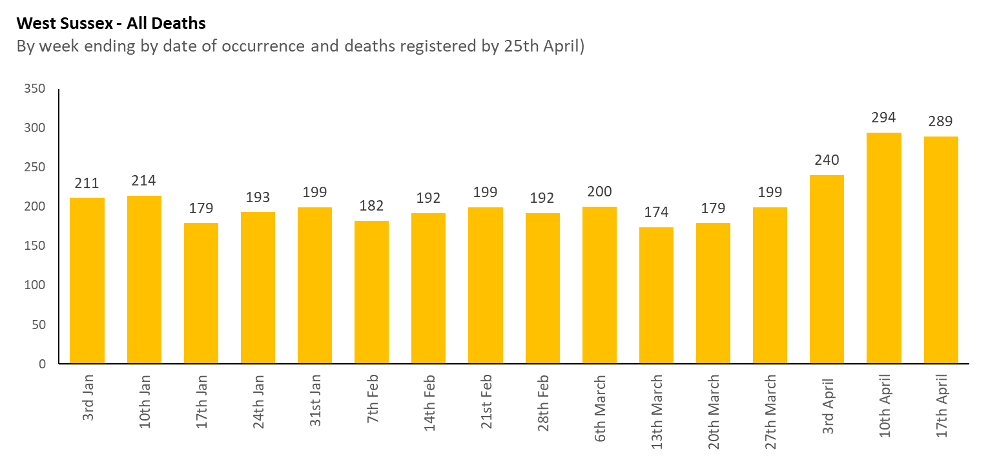
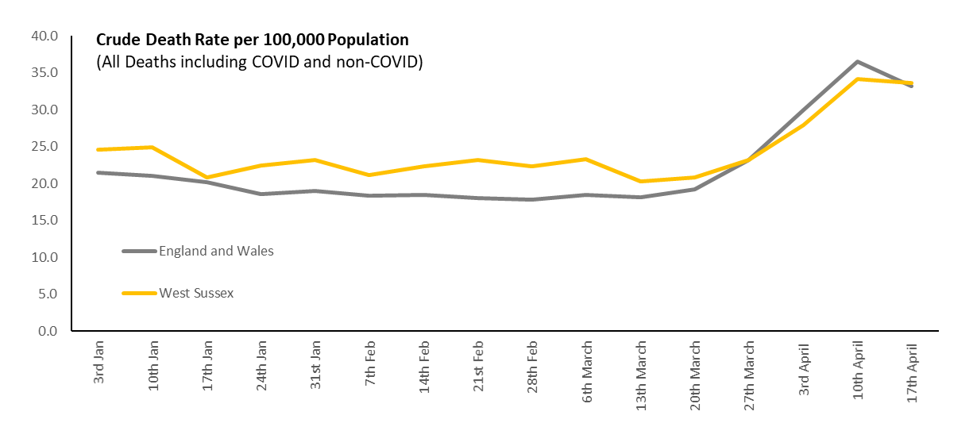
Note figures are revised as there can be a lag in registrations, figures for week ending 17th April may also be revised upwards as the period includes Easter
Deaths - Residents
Figures relate to deaths of people who are usually resident in West Sussex (i.e. includes people who have died outside of the county)
Relate to date of occurrence of death, and include deaths registered by 25^{h} April, these may be subject to some minor revision.
Deaths have risen considerably in the last week of March and into weeks in April.
In relation to week 16, looking at data between 2001 and 2019 the previous (equivalent week) highest figure was 205, the average 177.
Note: Figures for week 15 were revised up (from 273 to 294) due to the registration time lag and although fewer deaths are shown in week 16, the week covered included Easter, and as with week 15 there may be some upward revision.
Note that this is a crude rate, West Sussex has an older population compared with England and Wales and so the rate is usually, and expectedly, above the national rate.
The crude rate of death (that is not age standardised) has risen considerably nationally and locally.
This increase started towards the end of March.
This graph shows the considerable increase at a national level, so that local and national crude rates are similar.
As above – the rate may be revised

Slide 4
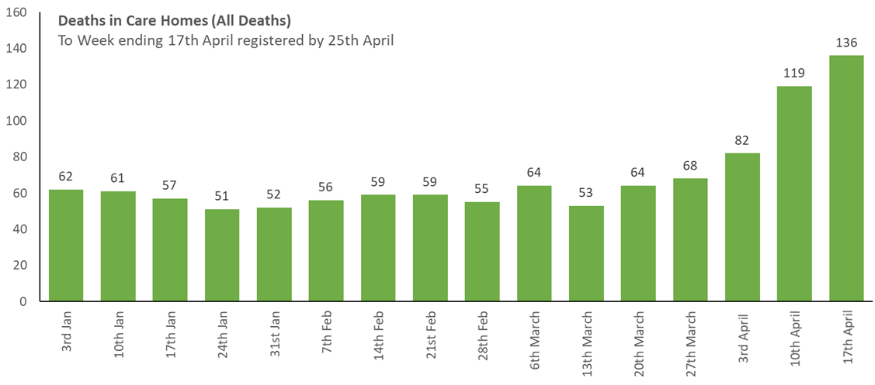

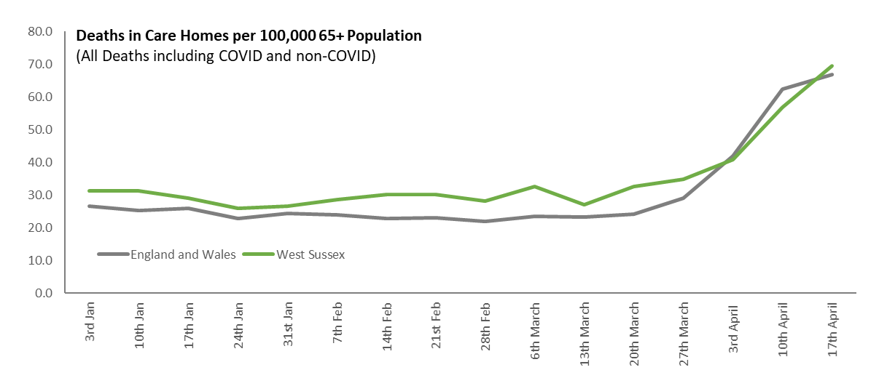
Deaths – Deaths in Care Homes – All Deaths
Relate to date of occurrence of death, and include deaths registered by 18th April, these may be subject to some minor revision.
Deaths have risen considerably in the last week of March and into two weeks in April. The number of deaths has now doubled since the last week in March.
The rate of death (that is not age standardised to any detailed grouping of age) has risen considerably nationally and locally.
This increase started towards the end of March.
This graph shows the considerable increase at a national level, so that local and national crude rates are similar.

Slide 5
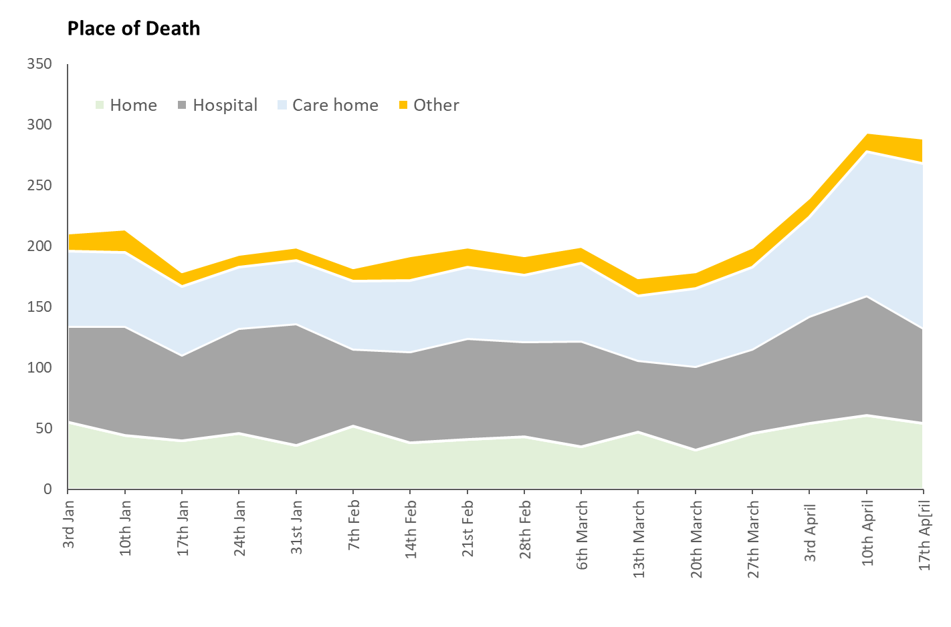
Deaths – Place of Death (ALL DEATHS – COVID and non-COVID)
Figures relate to deaths of people who are usually resident in West Sussex (i.e. includes people who have died outside of the county)
Relate to date of occurrence of death, and include deaths registered by 25th April, these may be subject to some minor revision.
The highest proportion of deaths, of West Sussex residents, in week ending 17th April were in care homes, with 47% of deaths compared with 27% of deaths in hospital.
This is the national figure
 | 3rd | 10th Jan | 17th Jan | 24th Jan | 31st | 7th | 14th Feb | 21st Feb | 28th Feb | 6th March | 13th Macrh | 20th March | 27th March | 3rd April | 10th April | 17th April | 17th National
 | Jan |  |  |  | Jan | Feb
Care home | 29% | 29% | 32% | 26% | 26% | 31% | 31% | 30% | 29% | 32% | 30% | 36% | 34% | 34% | 40% | 47% | 37%
Hospital | 37% | 42% | 39% | 45% | 50% | 35% | 39% | 42% | 41% | 44% | 34% | 39% | 35% | 37% | 33% | 27% | 40%
Home | 26% | 21% | 22% | 24% | 18% | 29% | 20% | 21% | 22% | 18% | 27% | 18% | 23% | 23% | 21% | 19% | 19%
Hospice | 5% | 6% | 6% | 5% | 4% | 5% | 9% | 7% | 7% | 7% | 7% | 7% | 6% | 5% | 5% | 5% | 2%
Other | 2% | 3% | 1% | 0% | 2% | 1% | 2% | 1% | 1% | 1% | 2% | 1% | 3% | 1% | 1% | 2% | 2%

Slide 6
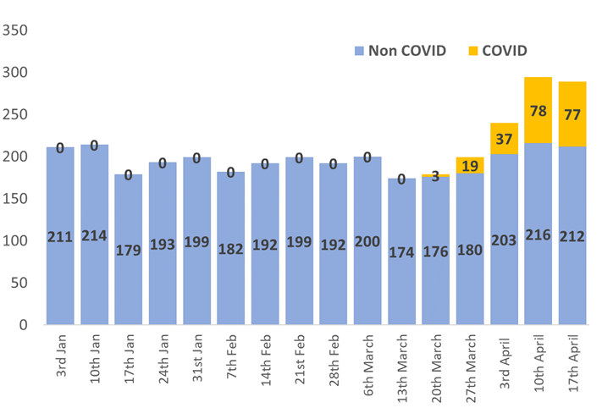
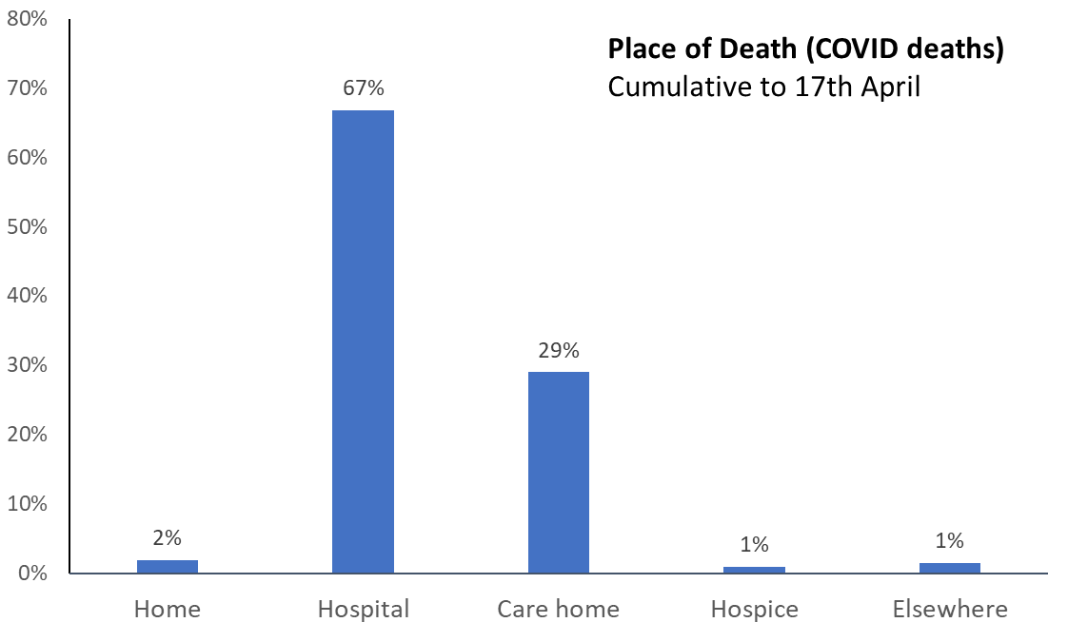
Deaths – COVID and non-COVID Deaths
Note: From 31 March 2020 figures also show the number of deaths involving coronavirus (COVID-19), based on any mention of COVID-19 on the death certificate.
By week ending 17th April there had been 214 deaths with COVID on the certificate
Area name | Home | Hospital | Care home | Hospice | Elsewhere
Adur | 0 | 3 | 4 | 2 | 1
Arun | 0 | 19 | 3 | 0 | 0
Chichester | 1 | 17 | 11 | 0 | 0
Crawley | 0 | 28 | 6 | 0 | 0
Horsham | 3 | 25 | 10 | 0 | 2
Mid Sussex | 0 | 39 | 22 | 0 | 0
Worthing | 0 | 12 | 6 | 0 | 0
TOTAL | 4 | 143 | 62 | 2 | 3
Note this graph and table relate to cumulative COVID deaths to 17th April

Slide 7
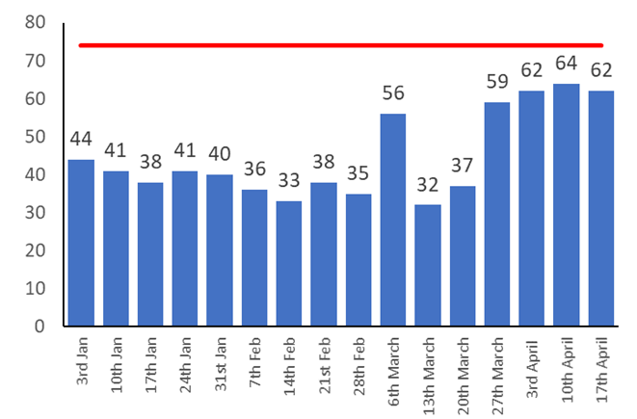
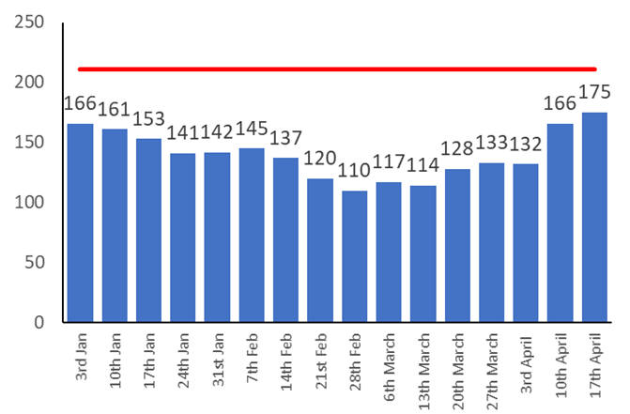
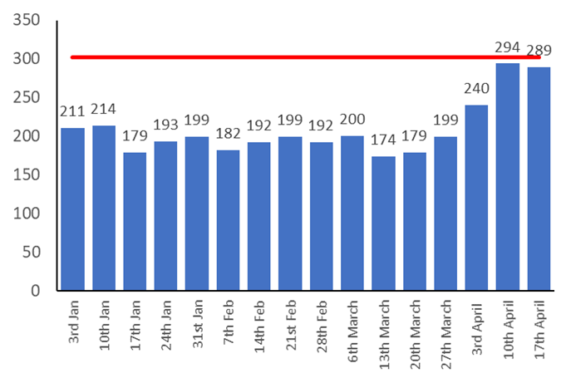
Deaths – Sussex LAs
Brighton and Hove
East Sussex
West Sussex
The red lines shown on the graph is the highest week assumption MHCLG/PHE have advised to use for death management planning, for Brighton and Hove this was 74, East Sussex 211, and West Sussex 302.
In week ending 17th April, the number of deaths were at 90% of this total overall, but this ranged from 83% in East Sussex, 84% in Brighton and Hove and 96% in West Sussex

Slide 8
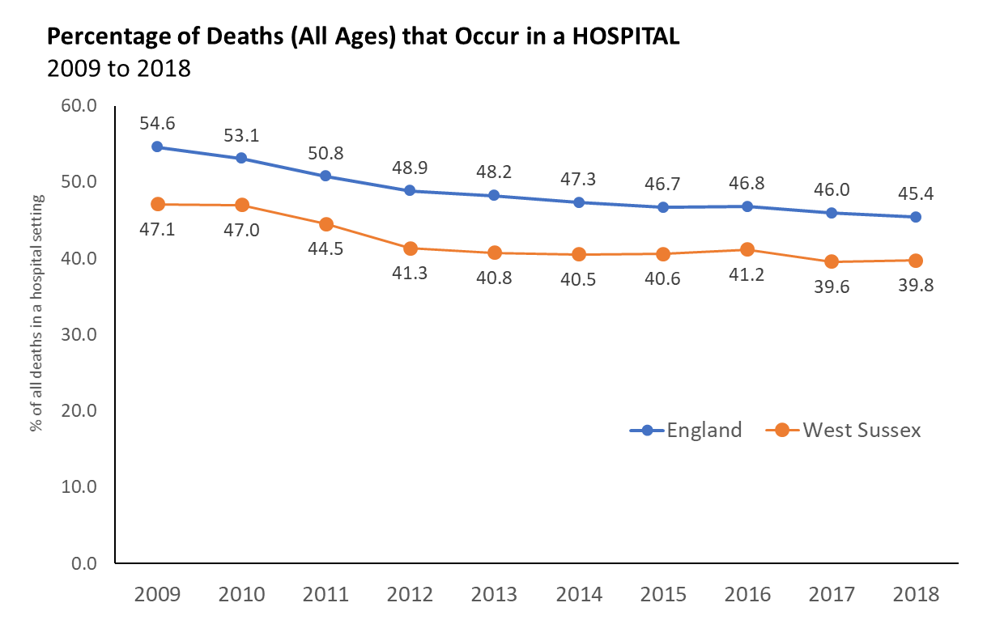
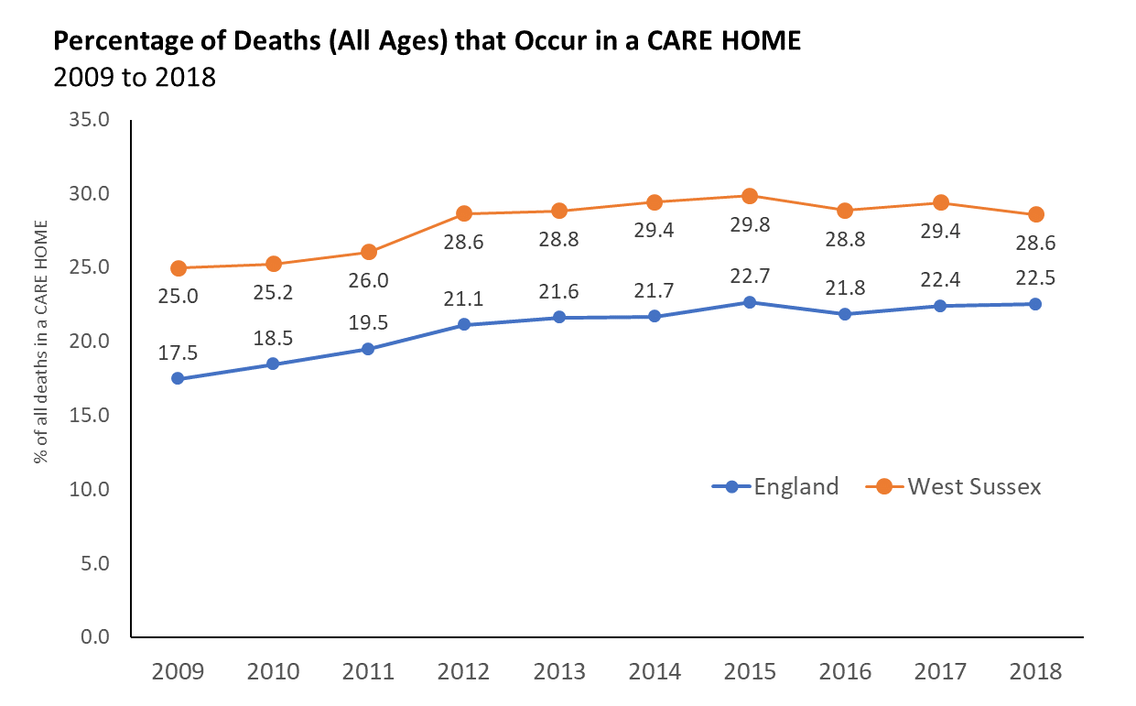
Deaths – Trend of Deaths in Hospital (%) and Deaths in a Care Homes (%)
Over the longer term, nationally and in West Sussex, the percentage of people dying in hospital has declined, and people dying in a care home setting ,and as their usual place of residence, has increased. This change has happened as national and local End of Life Strategies have moved to support people make decisions and choices about their end of life care.
With an older population West Sussex has an higher percentage of deaths in a care home. In 2018 approx. 29% of deaths were in a care home compared with 22.5% nationally.
In relation to deaths in hospital, this has fallen from 47% in 2009 in West Sussex to just below 40% in 2018.
Source : PHE Palliative and End of Life Care Profiles

Slide 9
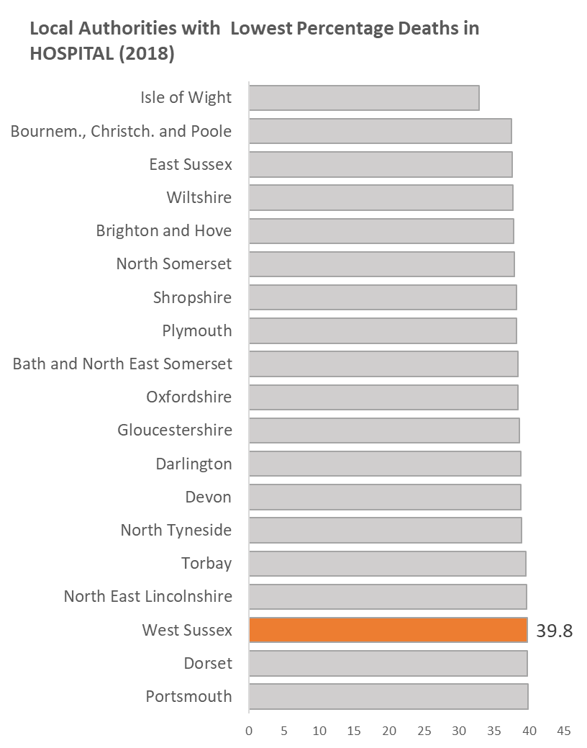
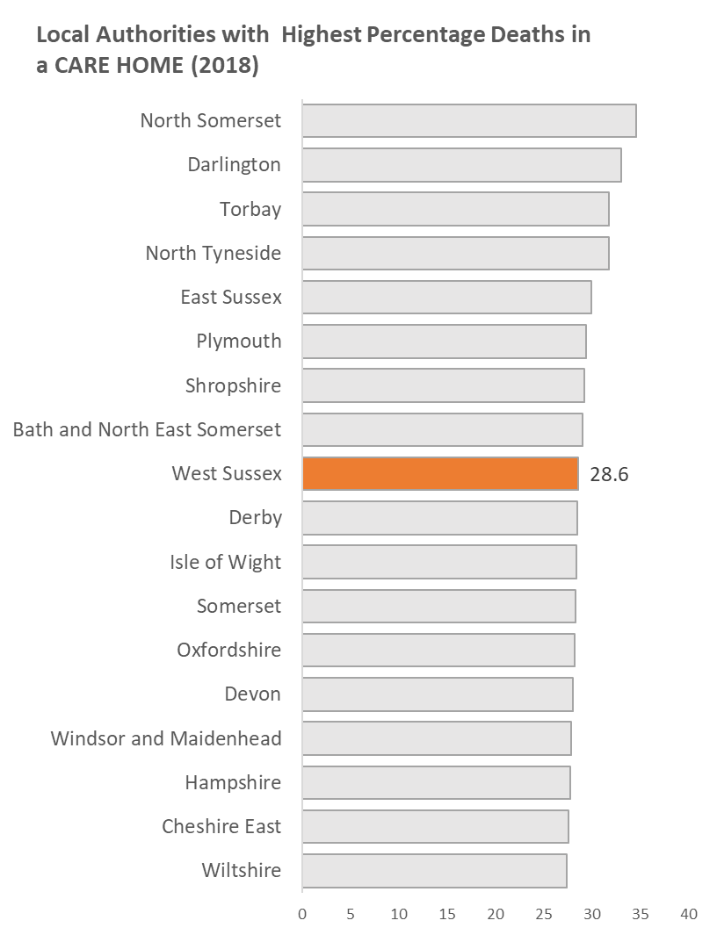
Deaths – Deaths in a Care Homes (%) and % in Hospitals compared with other areas
In terms of deaths in a care home – West Sussex was 9th HIGHEST in the country in 2018
In terms of the % of deaths in a hospital – West Sussex was 17th LOWEST in the country in 2018 (out of 151 authorities)
Source : PHE Palliative and End of Life Care Profiles

